Slide 1

AOLME Curriculum

Slide 2


Level 1
SESSION 1: Basic of Raspberry PI and Linux-(motivational overview of projects-images, ls, cd, to find and play previous videos) SESSION 2: Introduction to Python (print, for, if) SESSION 3: Algorithms (for loops-arithmetic progressions, if statements-ranges, inequalities) SESSION 4: The Coordinate Plane and Black & White Images in Python SESSION 5: Binary and Hexadecimal number systems SESSION 6: Images and Their Components (histograms) SESSION 7: Creation of Images and Video FINAL PROJECT: VIDEO

Slide 3
The Coordinate Plane and Black & White Images in Python
OBJECTIVES:
Identify the connections between x-y coordinate plane and use of binary numbers to represent black and white images.
Design basic black and white images.
Program binary images using Python.

Slide 4

Selected ACTIVITIES
1. Creating a black and white image using the “Binary Image Generator” (binary colors, open play)
2. Using Coordinates in Black & White Images w/ paper (coordinates, grouping, blocks, share and modify-’debug’)
3. Creating and programming matrices, arrays, and ranges to create images with python (debug, program, share and modify-DMI)

Slide 5
Roles in Activity
roles
NORMS
Leader / Facilitator
Set up Person / Take Down Person
Checker
Safety Monitor
Recorder/ Reporter/ Synthesizer
Say your own ideas
Listen to others; give everyone a chance to talk
Ask others for their ideas
Give reasons for your ideas and discuss many different ideas (p.63).

Slide 6
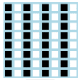

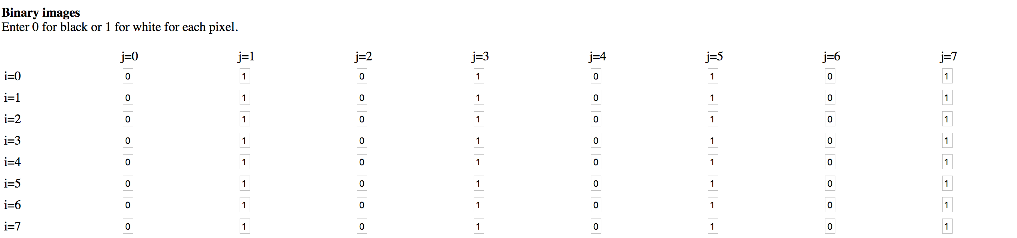
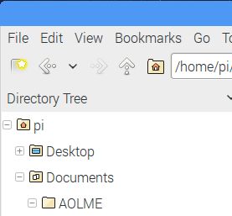
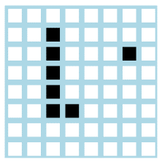

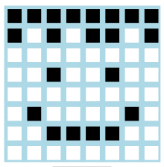

4.1. Creating Images w/ the “Binary Image Generator”
1. Navigate folders of your Raspberry Pi and go to folder: /pi/AOLME/Session 4/ and open or double click on the link “Binary Image Generator”
What are the ‘i’ and ‘j’ for? How are the numbers and the colors in the grid related?
3. How are numbers and colors linked? Scroll down and look at the Python code. What does it tell us? Based on what you learned, create a black & white image.
4. Discuss & Write: How do you make white and black pixels? Can you make a circle and round corners with the “Binary Image Generator” ? Why yes or why not?
AOLME PROJECT - LEVEL 1- SESSION 4- 2018
Notes:
Reduce number of codes P
Provide examples of images and how they were pixelated

Slide 7
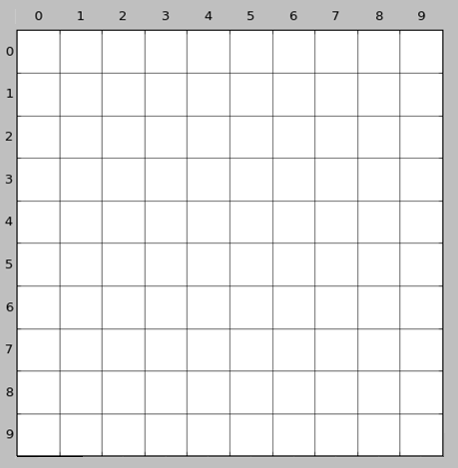
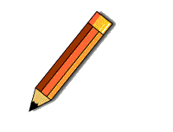




4.2. Using Coordinates in Black & White Images
Remember the ‘i’ and the ‘j’ we used? How are these a coordinate plane?
2. After completing the image, notice how each square, or pixel, has a specific position.
How are the coordinate system different from what we have studied before?
1. Create a figure by filling in complete squares with black.
name each pixel like this:
1R – 3C
3. Find a partner in your group-and tell her/him and try to have them draw the same as you but without looking at your sheet.
4. Would there be a way of telling your partner the information for your image in a briefer way? (other pairs)
1R-3C
AOLME PROJECT - LEVEL 1- SESSION 4- 2018
Notes:
Reduce number of codes P
Provide examples of images and how they were pixelated

Slide 8
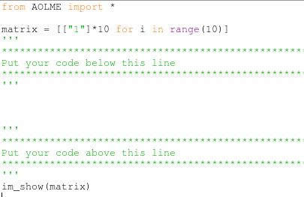
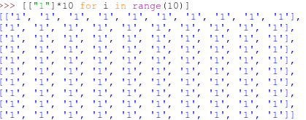
4.3. Programming images with Python
Open in python script to see how images are programmed.
Go to: /pi/AOLME/Session 4/Student Projects/ called “BW1.py”
2. What would these codes show? Why?
Predict images and change the code of image from an image created by cohort 1
← Here we import the AOLME library.
← This creates a blank matrix!
What do these codes do?
← Your code goes here!
← This function defined in AOLME.py lets us see the matrix we created.
3. What do these codes do?
4. In your group, design and program an image that will represent your team. Take turns typing in the codes. Save it with a funny name. Then, show it to another team.
from AOLME import *
matrix = [["1"]*10 for i in range(10)]
for row in range(10):
matrix[row][4] = "0"
for col in range(10):
matrix[0][col] = "0"
im_show(matrix)
Think: If you were to create rectangle (vertical or horizontal), what would be the fastest way to create a rectangle?
AOLME PROJECT - LEVEL 1- SESSION 4- 2018
Notes:
Reduce number of codes P
Provide examples of images and how they were pixelated

Slide 9
2. Creating a black and white image using the “Binary Image Generator”
Navigate the file system and open the link to “Binary Image Generator” inside the folder /pi/AOLME/Session 4/ by double clicking.
The 8x8 matrices show black and white images. Each tiny square is called “pixel”.
In Python, the white squares (white pixels) are represented by the value ‘1’ and the black squares (black pixels) by the value ‘0’.
Notes:
Pixelated images
Images and social impact-

